Slide 1


Modern C++ Course
Gammasoft

Slide 2

Who am I ?
Gammasoft
Gammasoft aims to make c++ fun again.
About
Gammasoft is the nickname of Yves Fiumefreddo.
More than thirty years of passion for high technology especially in development (c++, c#, objective-c, ...).
Object-oriented programming is more than a mindset.
more info see my GitHub : https://github.com/gammasoft71
Gammasoft
Modern C++ Course

Slide 3
Outline
Introduction
Language Basics
Object Oriented Programming (OOP)
Core Modern C++
Modern C++ Expert
Advanced Programming
Gammasoft
Modern C++ Course

Slide 4
Outline
Introduction
Language Basics
Object Oriented Programming (OOP)
Core Modern C++
Modern C++ Expert
Advanced Programming
Gammasoft
Modern C++ Course
Notes:
Check that all dev environments have been installed.
Answer questions if necessary...
Clone modern_cpp_course : git clone https://github.com/gammasoft71/modern_cpp_course.git
Or download : https://github.com/gammasoft71/modern_cpp_course/archive/refs/heads/main.zip

Slide 5
Outline
Introduction
Language Basics
Object Oriented Programming (OOP)
Core Modern C++
Modern C++ Expert
Advanced Programming
Gammasoft
Modern C++ Course

Slide 6
Language Basics
Language Basics
Gammasoft
Modern C++ Course
Hello World
Core syntax and types
Arrays and Pointers
Scopes / namespaces
Struct and enum types
References
Functions
Operators
Control structures
Headers and interfaces
auto keyword
inline keyword
Assertions

Slide 7
Language Basics
Language Basics
Gammasoft
Modern C++ Course
Hello World
Core syntax and types
Arrays and Pointers
Scopes / namespaces
Struct and enum types
References
Functions
Operators
Control structures
Headers and interfaces
auto keyword
inline keyword
Assertions

Slide 8
The first classic application
C++98
Language Basics | Hello World
Gammasoft
Modern C++ Course

Slide 9
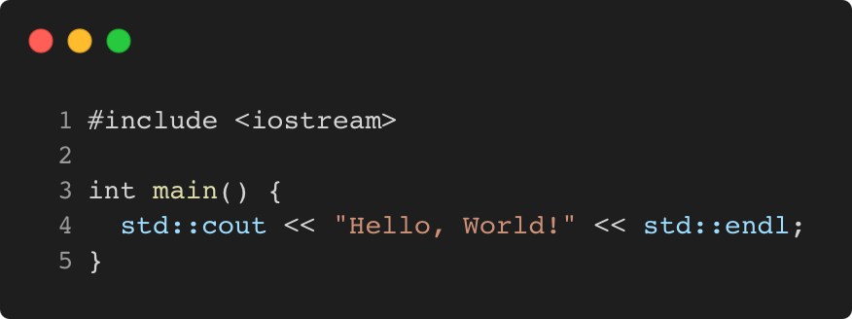
The first classic application
C++98
Language Basics | Hello World
program.cpp
Gammasoft
Modern C++ Course
Notes:
int main() explanation (argument see slide 16 : main function)
function and braces
std::cout, std::cin, std::endl, ... stream and iostream explanation
#include file explanation

Slide 10
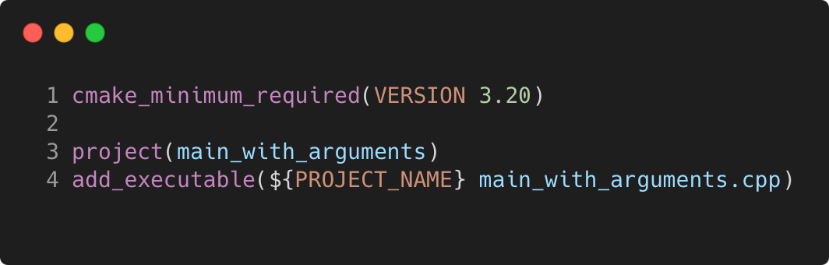
The first classic application
C++98
Language Basics | Hello World
program.cpp
CMakeLists.txt
Gammasoft
Modern C++ Course

Slide 11
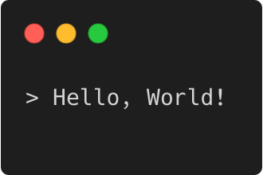
The first classic application
C++98
Language Basics | Hello World
program.cpp
CMakeLists.txt
Output
Gammasoft
Modern C++ Course

Slide 12
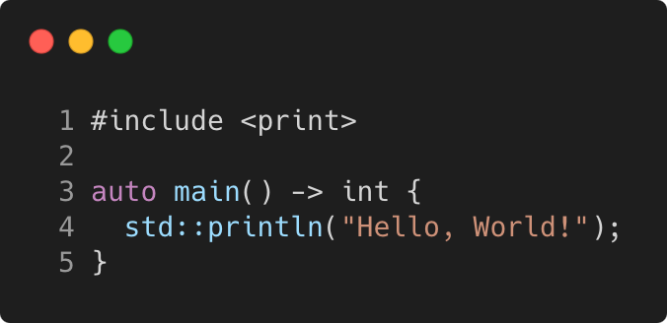
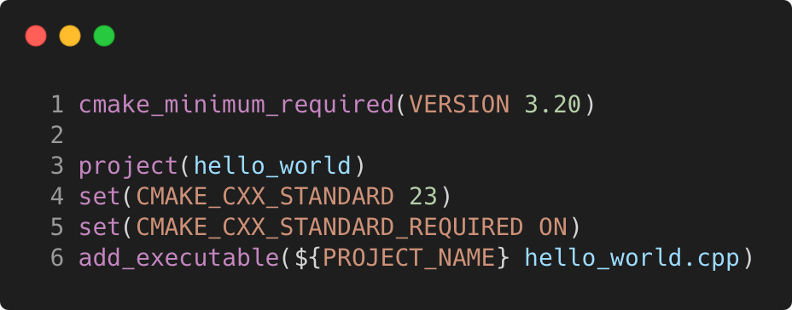
The first classic application
C++23
Language Basics | Hello World
program.cpp
CMakeLists.txt
Output
Gammasoft
Modern C++ Course

Slide 13
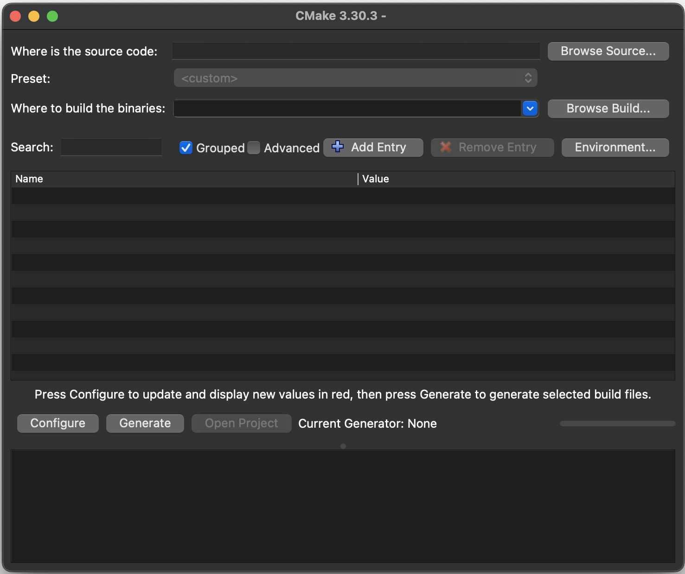
Execute with CMake GUI
Language Basics | Hello World
Open the CMake GUI application
Click on "Browse Sources..." button and select the "Hello world" folder.
Copy the path from "Where is the source code:", past it in the "Where to build the binaries:" and add "/build".
Click on "Configure" button and select the generator.
Click on "Generate" button to generate the project.
Finally, click on “Open project” button.
Gammasoft
Modern C++ Course

Slide 14
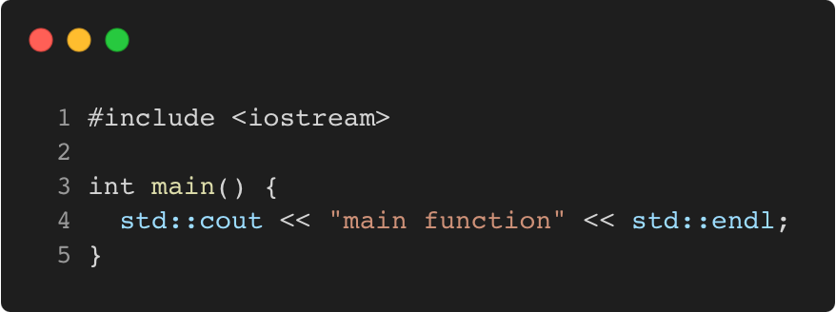
Main function
C++98
Language Basics | Hello World
Gammasoft
Modern C++ Course

Slide 15
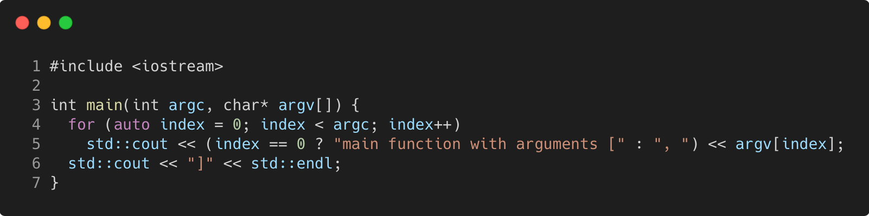
Main function
C++98
Language Basics | Hello World
Gammasoft
Modern C++ Course
Notes:
argc, argv explanation

Slide 16
Exercise : environment
Language Basics | Hello World
Learn how to use CMake to generate a project.
Go to exercises/environment
Look at environment.cpp and CMakeLists.txt
Compile it (make) and run the program (./environment)
Work on the tasks that you find in environment.cpp
Gammasoft
Modern C++ Course

Slide 17
Language Basics
Language Basics
Gammasoft
Modern C++ Course
Hello World
Core syntax and types
Arrays and Pointers
Scopes / namespaces
Struct and enum types
References
Functions
Operators
Control structures
Headers and interfaces
auto keyword
inline keyword
Assertions

Slide 18
Language Basics
Language Basics
Gammasoft
Modern C++ Course
Hello World
Core syntax and types
Arrays and Pointers
Scopes / namespaces
Struct and enum types
References
Functions
Operators
Control structures
Headers and interfaces
auto keyword
inline keyword
Assertions

Slide 19
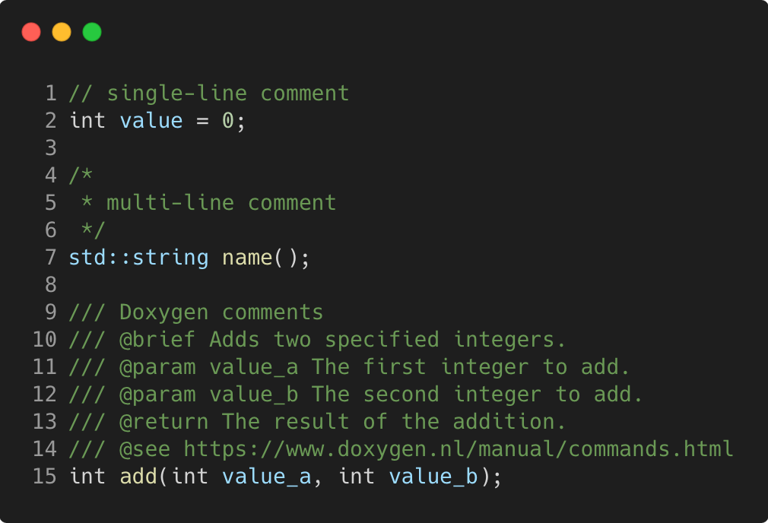
Comments
C++98
Language Basics | Core syntax and types
Gammasoft
Modern C++ Course

Slide 20
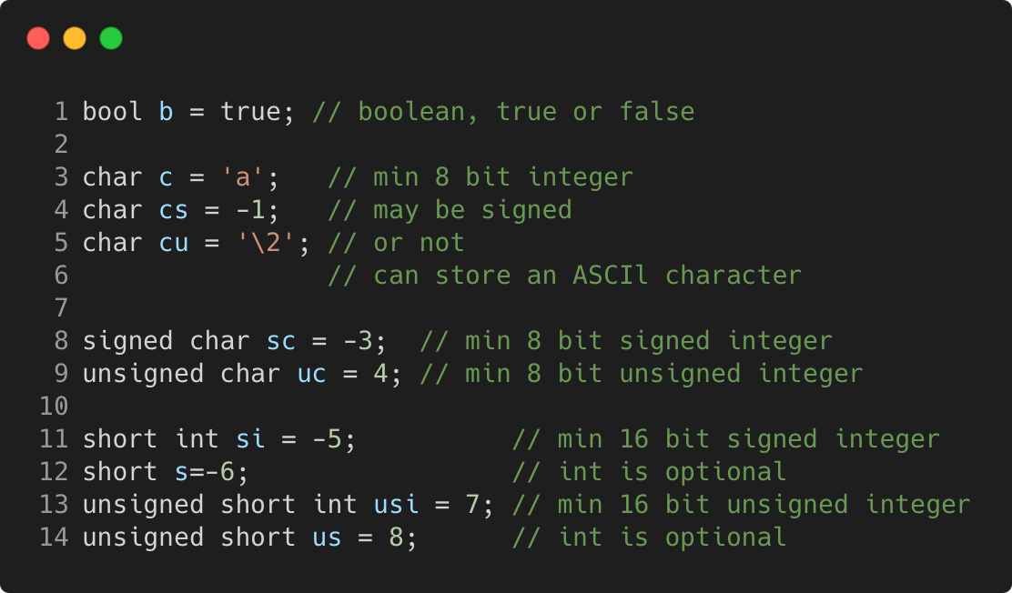
Basic types
C++98
Language Basics | Core syntax and types
Gammasoft
Modern C++ Course

Slide 21
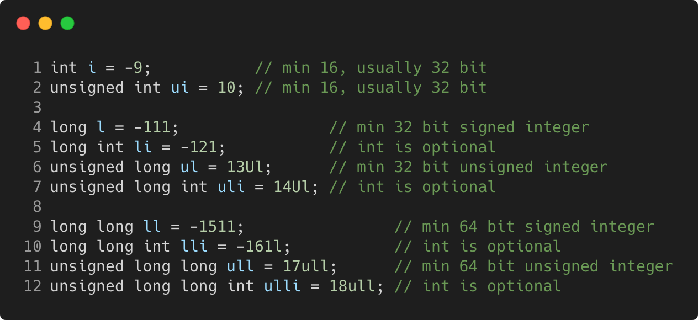
Basic types
C++98
Language Basics | Core syntax and types
Gammasoft
Modern C++ Course

Slide 22
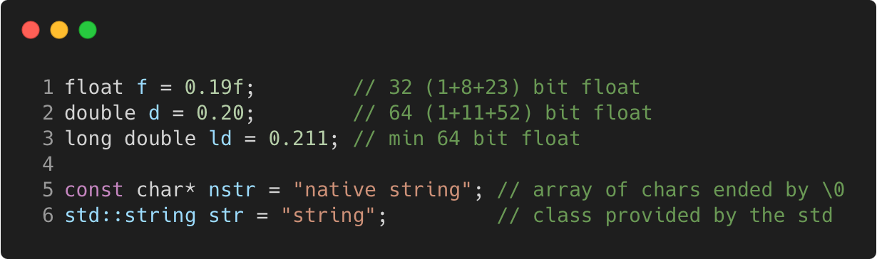
Basic types
C++98
Language Basics | Core syntax and types
Gammasoft
Modern C++ Course

Slide 23
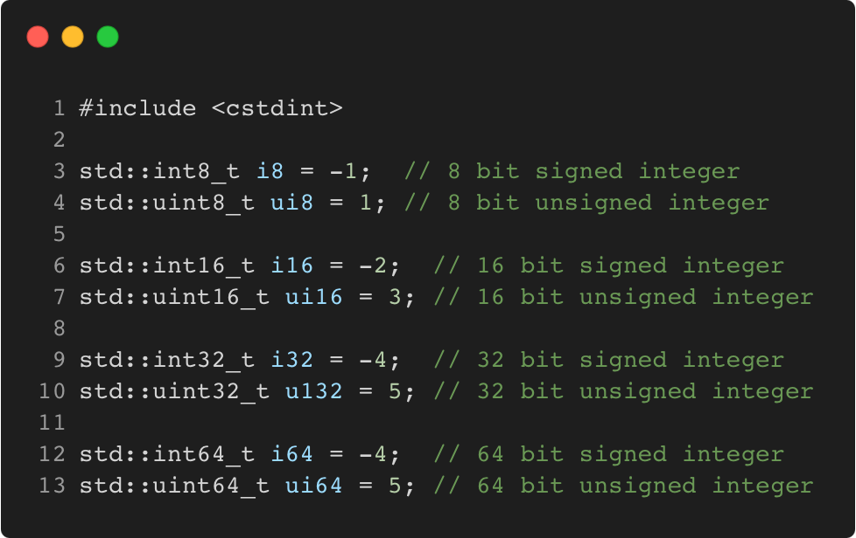
Fixed width integer types
C++11
Language Basics | Core syntax and types
Gammasoft
Modern C++ Course

Slide 24
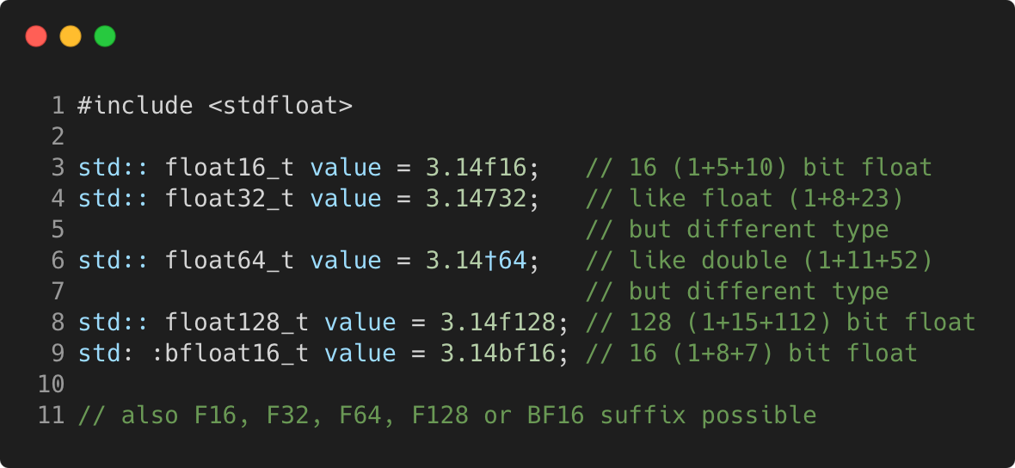
Fixed width floating-point types
C++23
Language Basics | Core syntax and types
Gammasoft
Modern C++ Course

Slide 25
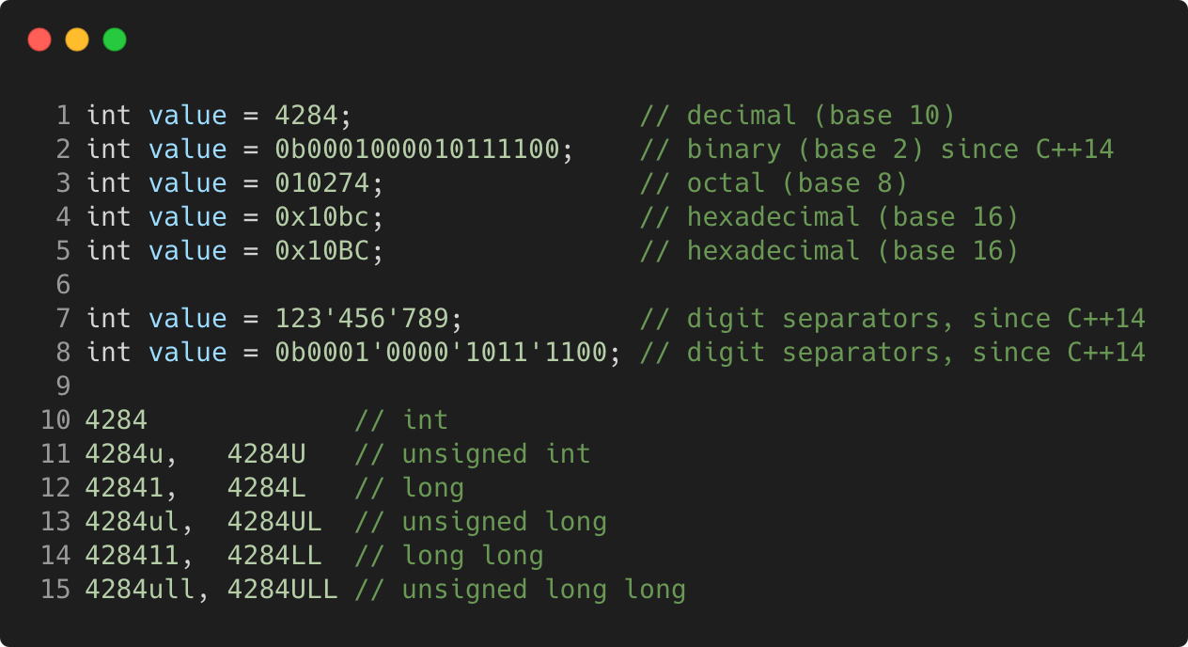
Integer literals
C++98
Language Basics | Core syntax and types
Gammasoft
Modern C++ Course

Slide 26
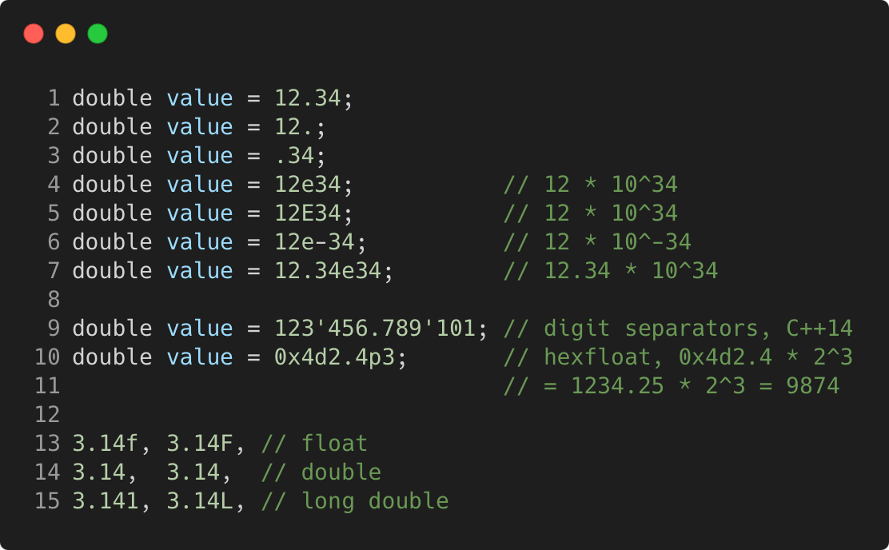
Floating-point literals
C++98
Language Basics | Core syntax and types
Gammasoft
Modern C++ Course

Slide 27
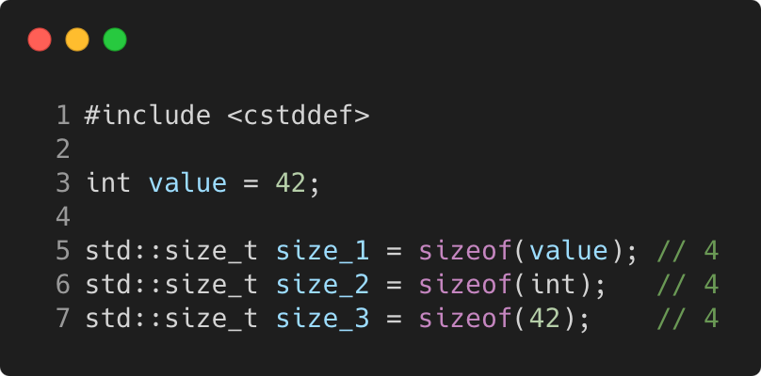
Sizeof
C++98
Language Basics | Core syntax and types
Gammasoft
Modern C++ Course

Slide 28
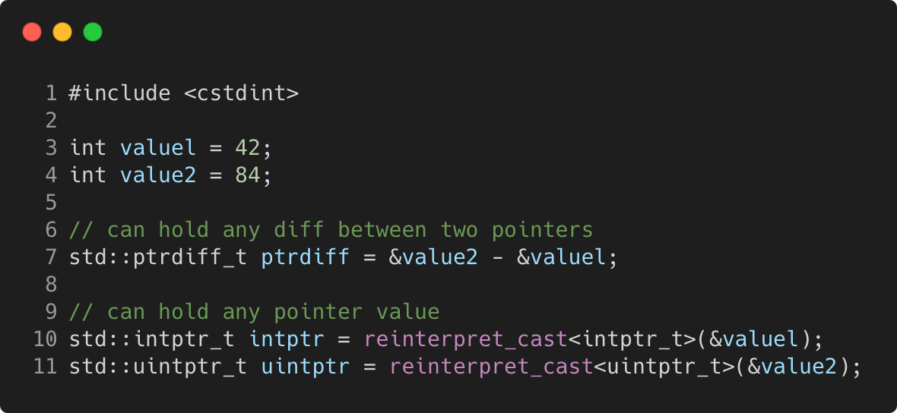
Pointer to integer
C++11
Language Basics | Core syntax and types
Gammasoft
Modern C++ Course

Slide 29
Language Basics
Language Basics
Gammasoft
Modern C++ Course
Hello World
Core syntax and types
Arrays and Pointers
Scopes / namespaces
Struct and enum types
References
Functions
Operators
Control structures
Headers and interfaces
auto keyword
inline keyword
Assertions

Slide 30
Language Basics
Language Basics
Gammasoft
Modern C++ Course
Hello World
Core syntax and types
Arrays and Pointers
Scopes / namespaces
Struct and enum types
References
Functions
Operators
Control structures
Headers and interfaces
auto keyword
inline keyword
Assertions

Slide 31
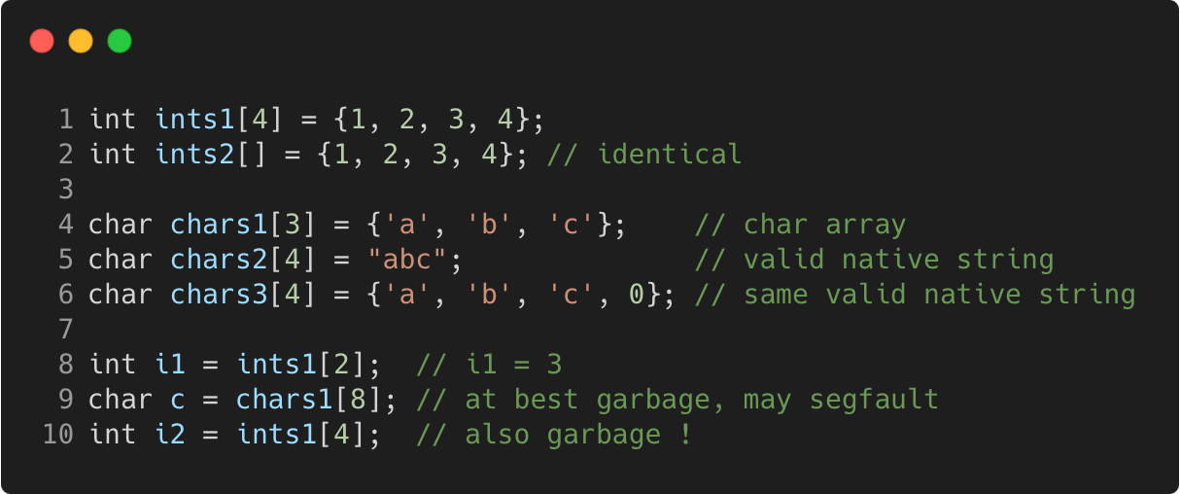
Static arrays
C++98
Language Basics | Arrays and Pointers
Gammasoft
Modern C++ Course

Slide 32
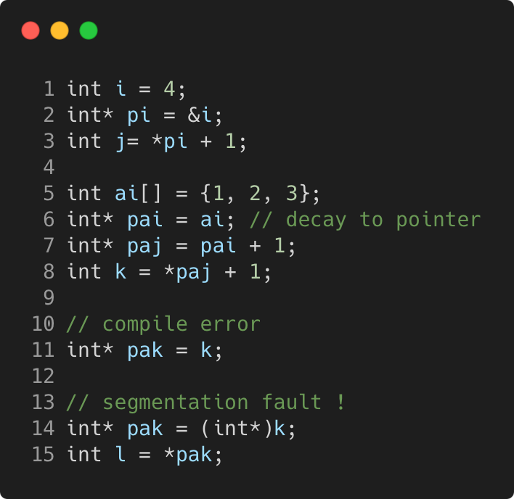
Pointers
C++98
Language Basics | Arrays and Pointers
Gammasoft
Modern C++ Course

Slide 33
Pointers
C++98
Language Basics | Arrays and Pointers
Memory layout
 | 0x3028 300
 | 0x3024
 | 0x3020 300
 | 0x301C
 | 0x3018 300
 | 0x3014
 | 0x3010 300
 | 0x300C
 | 0x3008 300
 | 0x3004
i = 4 | 0x3000 300
Gammasoft
Modern C++ Course

Slide 34
Pointers
C++98
Language Basics | Arrays and Pointers
Memory layout
 | 0x3028 300
 | 0x3024
 | 0x3020 300
 | 0x301C
 | 0x3018 300
 | 0x3014
 | 0x3010 300
 | 0x300C
 | 0x3008 300
pi = 0x3000 | 0x3004
i = 4 | 0x3000 300
Gammasoft
Modern C++ Course

Slide 35
Pointers
C++98
Language Basics | Arrays and Pointers
Memory layout
 | 0x3028 300
 | 0x3024
 | 0x3020 300
 | 0x301C
 | 0x3018 300
 | 0x3014
 | 0x3010 300
 | 0x300C
j = 5 | 0x3008 300
pi = 0x3000 | 0x3004
i = 4 | 0x3000 300
Gammasoft
Modern C++ Course

Slide 36
Pointers
C++98
Language Basics | Arrays and Pointers
Memory layout
 | 0x3028 300
 | 0x3024
 | 0x3020 300
 | 0x301C
 | 0x3018 300
ai[2] = 3 | 0x3014
ai[1] = 2 | 0x3010 300
ai[0] = 1 | 0x300C
j = 5 | 0x3008 300
pi = 0x3000 | 0x3004
i = 4 | 0x3000 300
Gammasoft
Modern C++ Course

Slide 37
Pointers
C++98
Language Basics | Arrays and Pointers
Memory layout
 | 0x3028 300
 | 0x3024
 | 0x3020 300
 | 0x301C
pai = 0x300C | 0x3018 300
ai[2] = 3 | 0x3014
ai[1] = 2 | 0x3010 300
ai[0] = 1 | 0x300C
j = 5 | 0x3008 300
pi = 0x3000 | 0x3004
i = 4 | 0x3000 300
Gammasoft
Modern C++ Course

Slide 38
Pointers
C++98
Language Basics | Arrays and Pointers
Memory layout
 | 0x3028 300
 | 0x3024
 | 0x3020 300
paj = 0x3010 | 0x301C
pai = 0x300C | 0x3018 300
ai[2] = 3 | 0x3014
ai[1] = 2 | 0x3010 300
ai[0] = 1 | 0x300C
j = 5 | 0x3008 300
pi = 0x3000 | 0x3004
i = 4 | 0x3000 300
Gammasoft
Modern C++ Course

Slide 39
Pointers
C++98
Language Basics | Arrays and Pointers
Memory layout
 | 0x3028 300
 | 0x3024
k = 3 | 0x3020 300
paj = 0x3010 | 0x301C
pai = 0x300C | 0x3018 300
ai[2] = 3 | 0x3014
ai[1] = 2 | 0x3010 300
ai[0] = 1 | 0x300C
j = 5 | 0x3008 300
pi = 0x3000 | 0x3004
i = 4 | 0x3000 300
Gammasoft
Modern C++ Course

Slide 40
Pointers
C++98
Language Basics | Arrays and Pointers
Memory layout
 | 0x3028 300
pak = 3 | 0x3024
k = 3 | 0x3020 300
paj = 0x3010 | 0x301C
pai = 0x300C | 0x3018 300
ai[2] = 3 | 0x3014
ai[1] = 2 | 0x3010 300
ai[0] = 1 | 0x300C
j = 5 | 0x3008 300
pi = 0x3000 | 0x3004
i = 4 | 0x3000 300
??
Gammasoft
Modern C++ Course

Slide 41
nullptr
C++11
Language Basics | Arrays and Pointers
if a pointer doesn’t point to anything, set it to nullptr
useful to e.g. mark the end of a linked data structure
or absence of an optional function argument (pointer)
same as setting it to 0 or NULL (before C++ 11)
triggers compilation error when assigned to integer
Gammasoft
Modern C++ Course

Slide 42
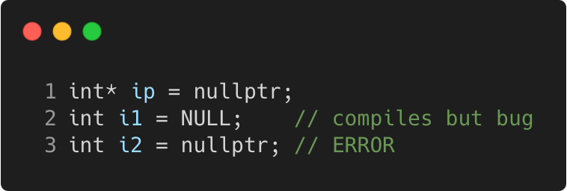
nullptr
C++11
Language Basics | Arrays and Pointers
if a pointer doesn’t point to anything, set it to nullptr
useful to e.g. mark the end of a linked data structure
or absence of an optional function argument (pointer)
same as setting it to 0 or NULL (before C++ 11)
triggers compilation error when assigned to integer
Gammasoft
Modern C++ Course

Slide 43
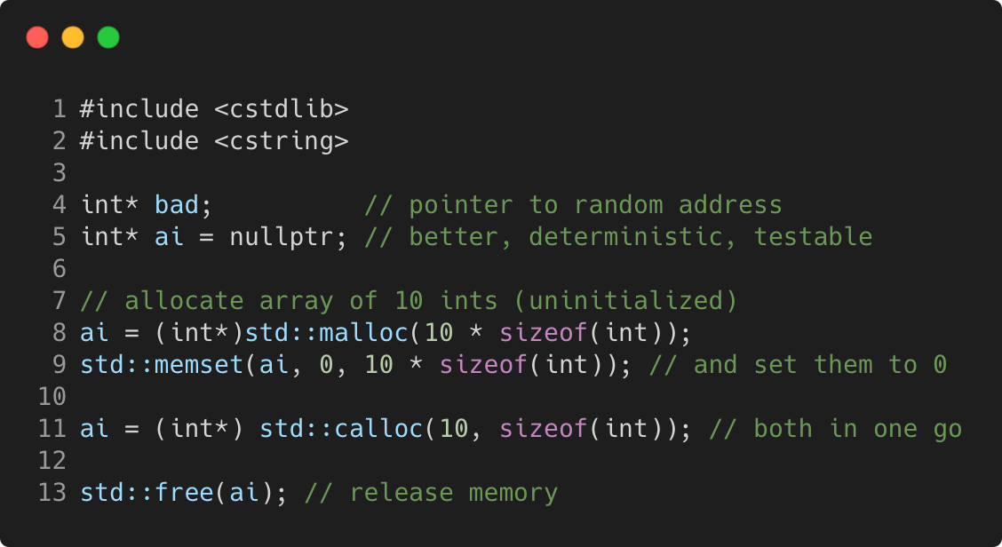
Dynamic arrays using C
C++98
Language Basics | Arrays and Pointers
Gammasoft
Modern C++ Course

Slide 44
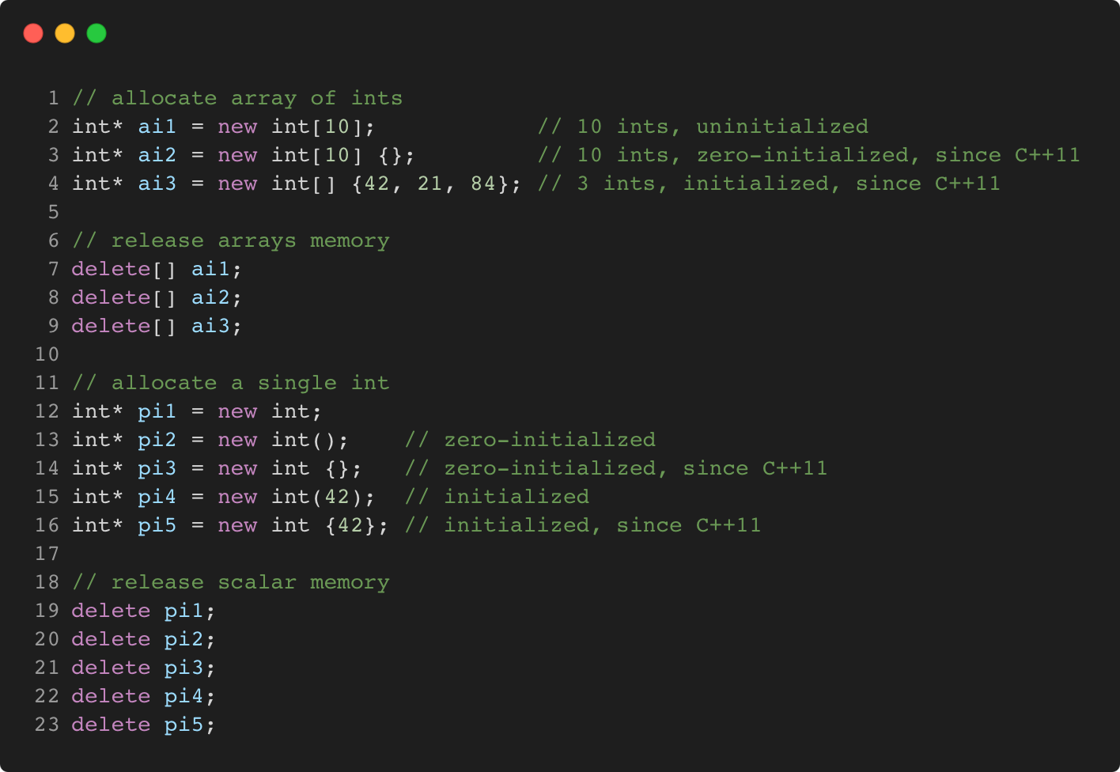
Dynamic arrays using C++
C++98
Language Basics | Arrays and Pointers
Gammasoft
Modern C++ Course

Slide 45
Language Basics
Language Basics
Gammasoft
Modern C++ Course
Hello World
Core syntax and types
Arrays and Pointers
Scopes / namespaces
Struct and enum types
References
Functions
Operators
Control structures
Headers and interfaces
auto keyword
inline keyword
Assertions

Slide 46
Language Basics
Language Basics
Gammasoft
Modern C++ Course
Hello World
Core syntax and types
Arrays and Pointers
Scopes / namespaces
Struct and enum types
References
Functions
Operators
Control structures
Headers and interfaces
auto keyword
inline keyword
Assertions

Slide 47
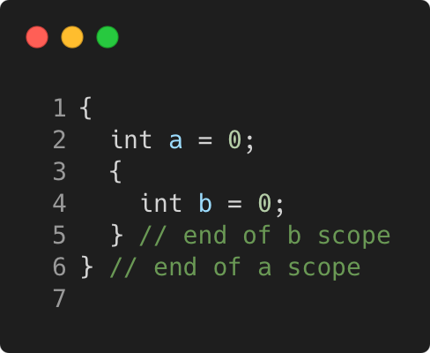
Scope
C++98
Language Basics | Scopes / namespaces
Portion of the source code where a given name is valid
Typically :
simple block of code, within {}
function, class, namespace
the global scope, i.e. translation unit (.cpp file + all includes)
Gammasoft
Modern C++ Course

Slide 48
Scope and lifetime of variables
C++98
Language Basics | Scopes / namespaces
Variables are (statically) allocated when defined
Variables are freed at the end of a scope
Gammasoft
Modern C++ Course

Slide 49
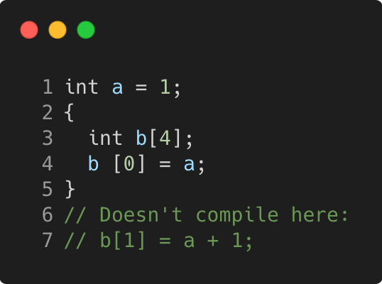
Scope and lifetime of variables
C++98
Language Basics | Scopes / namespaces
Variables are (statically) allocated when defined
Variables are freed at the end of a scope
Gammasoft
Modern C++ Course

Slide 50
Scope and lifetime of variables
C++98
Language Basics | Scopes / namespaces
Variables are (statically) allocated when defined
Variables are freed at the end of a scope
Memory layout
 | 0x3010
 | 0x300C
 | 0x3008
 | 0x3004
i = 4 | 0x3000
Gammasoft
Modern C++ Course

Slide 51
Scope and lifetime of variables
C++98
Language Basics | Scopes / namespaces
Variables are (statically) allocated when defined
Variables are freed at the end of a scope
Memory layout
b[3] = ? | 0x3010
b[2] = ? | 0x300C
b[1] = ? | 0x3008
b[0] = ? | 0x3004
i = 4 | 0x3000
Gammasoft
Modern C++ Course

Slide 52
Scope and lifetime of variables
C++98
Language Basics | Scopes / namespaces
Variables are (statically) allocated when defined
Variables are freed at the end of a scope
Memory layout
b[3] = ? | 0x3010
b[2] = ? | 0x300C
b[1] = ? | 0x3008
b[0] = 1 | 0x3004
i = 4 | 0x3000
Gammasoft
Modern C++ Course

Slide 53
Scope and lifetime of variables
C++98
Language Basics | Scopes / namespaces
Variables are (statically) allocated when defined
Variables are freed at the end of a scope
Memory layout
? | 0x3010
? | 0x300C
? | 0x3008
1 | 0x3004
i = 4 | 0x3000
Gammasoft
Modern C++ Course

Slide 54
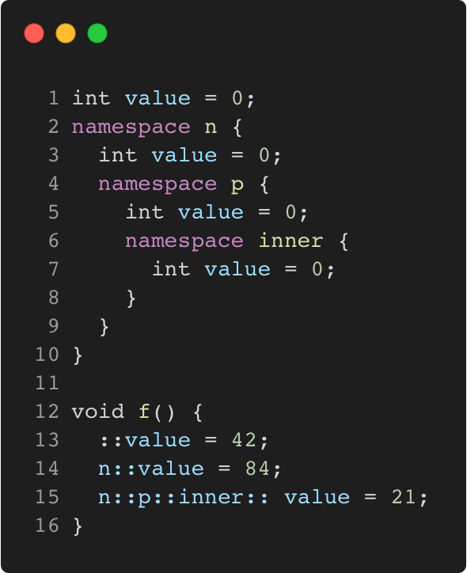
Namepaces
C++98
Language Basics | Scopes / namespaces
Namespaces allow to segment your code to avoid name clashes
They can be embedded to create hierarchies (separator is ::)
Gammasoft
Modern C++ Course

Slide 55
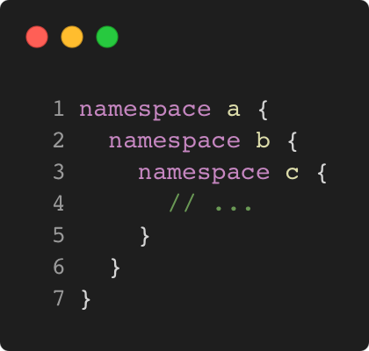
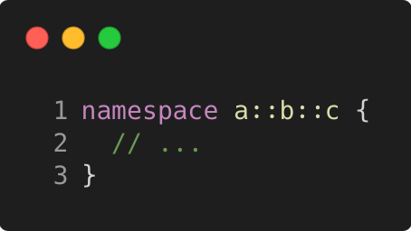
Nested namespaces
C++17
Language Basics | Scopes / namespaces
Easier way to declare nested namespaces
C++98
C++17
Gammasoft
Modern C++ Course

Slide 56
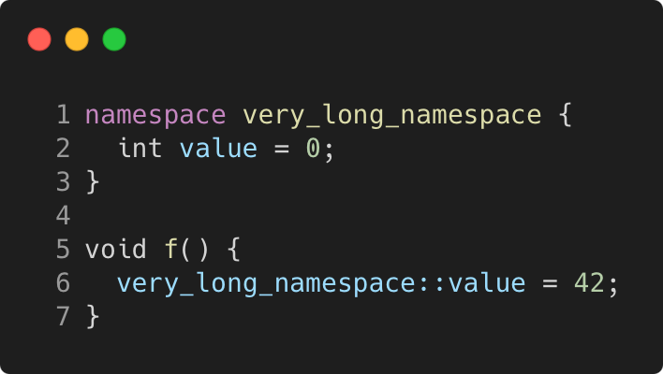
namespace alias
C++98
Language Basics | Scopes / namespaces
The namespace keyword can be use to create an alias on an other namespace.
Gammasoft
Modern C++ Course

Slide 57
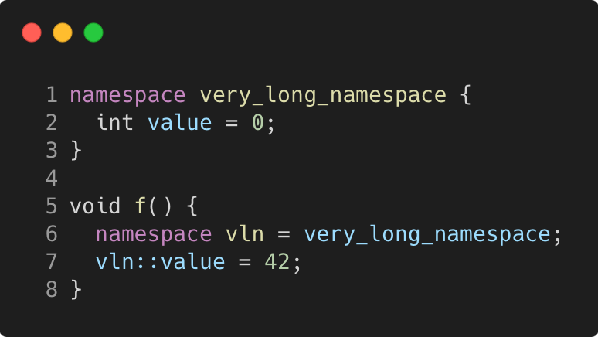
namespace alias
C++98
Language Basics | Scopes / namespaces
The namespace keyword can be use to create an alias on an other namespace.
Gammasoft
Modern C++ Course

Slide 58
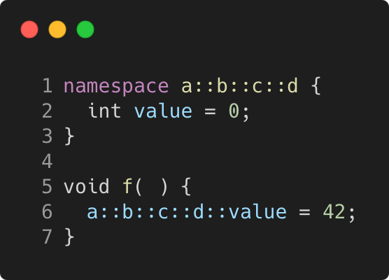
namespace alias
C++98
Language Basics | Scopes / namespaces
The namespace keyword can be use to create an alias on an other namespace.
Or on nested namespaces.
Gammasoft
Modern C++ Course

Slide 59
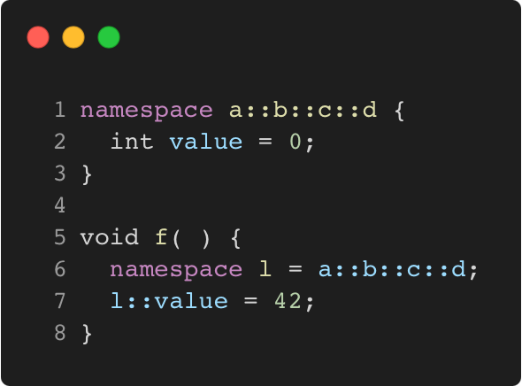
namespace alias
C++98
Language Basics | Scopes / namespaces
The namespace keyword can be use to create an alias on an other namespace.
Or on nested namespaces.
Gammasoft
Modern C++ Course

Slide 60
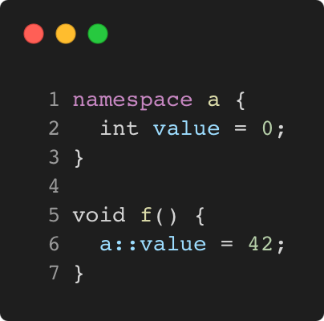
Using namespace directive
C++98
Language Basics | Scopes / namespaces
The using namespace directive make all members of the specified namespace visible in current scope.
Gammasoft
Modern C++ Course

Slide 61
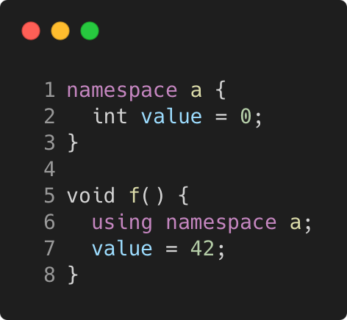
Using namespace directive
C++98
Language Basics | Scopes / namespaces
The using namespace directive make all members of the specified namespace visible in current scope.
Gammasoft
Modern C++ Course

Slide 62
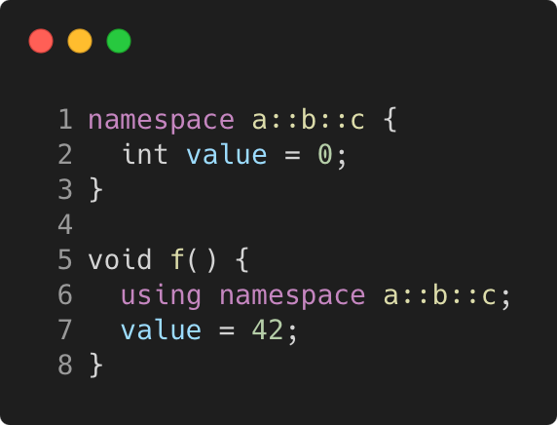
Using namespace directive
C++98
Language Basics | Scopes / namespaces
The using namespace directive make all members of the specified namespace visible in current scope.
The same for nested namespaces.
Gammasoft
Modern C++ Course

Slide 63
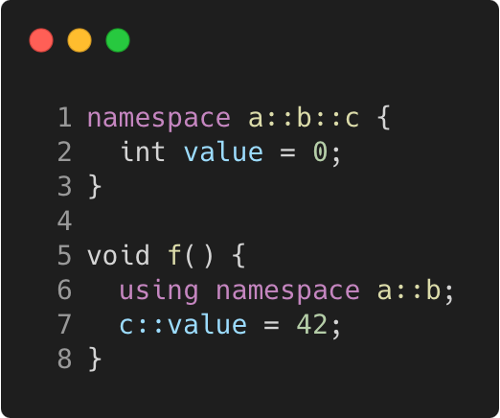
Using namespace directive
C++98
Language Basics | Scopes / namespaces
The using namespace directive make all members of the specified namespace visible in current scope.
The same for nested namespaces.
As well as for any part of the nested namespaces.
Gammasoft
Modern C++ Course

Slide 64
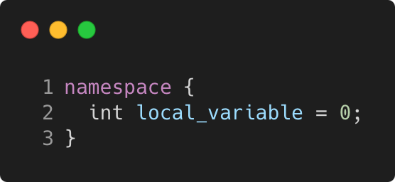
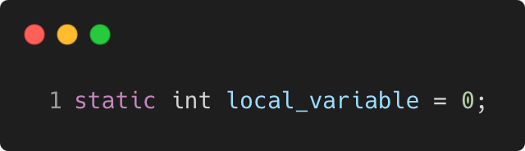
Anonymous namespace
C++98
Language Basics | Scopes / namespaces
groups a number of declarations
visible only in the current translation unit
but not reusable outside
allows much better compiler optimizations and checking
e.g. unused function warning
context dependent optimizations
equivalent
Gammasoft
Modern C++ Course

Slide 65
Language Basics
Language Basics
Gammasoft
Modern C++ Course
Hello World
Core syntax and types
Arrays and Pointers
Scopes / namespaces
Struct and enum types
References
Functions
Operators
Control structures
Headers and interfaces
auto keyword
inline keyword
Assertions

Slide 66
Language Basics
Language Basics
Gammasoft
Modern C++ Course
Hello World
Core syntax and types
Arrays and Pointers
Scopes / namespaces
Struct and enum types
References
Functions
Operators
Control structures
Headers and interfaces
auto keyword
inline keyword
Assertions

Slide 67
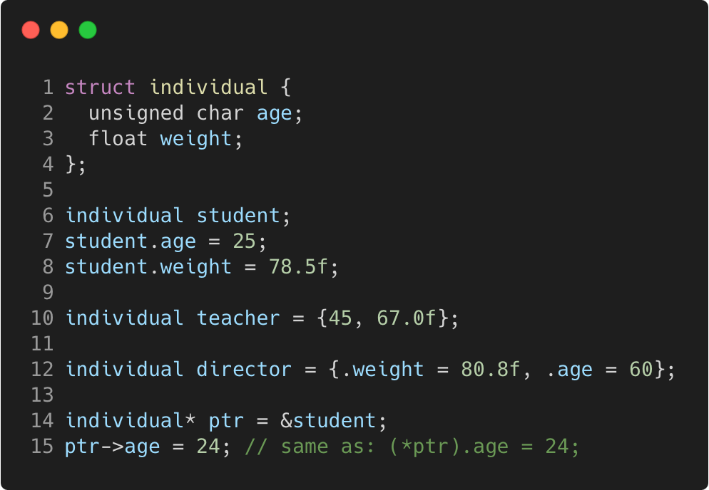
Struct
C++98
Language Basics | Struct and enum types
“members” grouped together under one name
Gammasoft
Modern C++ Course

Slide 68
Struct
C++98
Language Basics | Struct and enum types
“members” grouped together under one name
Memory layout
 |  |  |  | 0x3018
 |  |  |  | 0x3014
 |  |  |  | 0x3010
 |  |  |  | 0x300C
 |  |  |  | 0x3008
 |  |  |  | 0x3004
 |  |  |  | 0x3000
Gammasoft
Modern C++ Course

Slide 69
Struct
C++98
Language Basics | Struct and enum types
“members” grouped together under one name
Memory layout
 |  |  |  | 0x3018
 |  |  |  | 0x3014
 |  |  |  | 0x3010
 |  |  |  | 0x300C
 |  |  |  | 0x3008
? | ? | ? | ? | 0x3004
? | ? | ? | ? | 0x3000
{
student
Gammasoft
Modern C++ Course

Slide 70
Struct
C++98
Language Basics | Struct and enum types
“members” grouped together under one name
Memory layout
 |  |  |  | 0x3018
 |  |  |  | 0x3014
 |  |  |  | 0x3010
 |  |  |  | 0x300C
 |  |  |  | 0x3008
? | ? | ? | ? | 0x3004
25 | ? | ? | ? | 0x3000
{
student
Gammasoft
Modern C++ Course

Slide 71
Struct
C++98
Language Basics | Struct and enum types
“members” grouped together under one name
Memory layout
 |  |  |  | 0x3018
 |  |  |  | 0x3014
 |  |  |  | 0x3010
 |  |  |  | 0x300C
 |  |  |  | 0x3008
 |  |  |  | 0x3004
25 | ? | ? | ? | 0x3000
{
78.5
student
Gammasoft
Modern C++ Course

Slide 72
Struct
C++98
Language Basics | Struct and enum types
“members” grouped together under one name
Memory layout
 |  |  |  | 0x3018
 |  |  |  | 0x3014
 |  |  |  | 0x3010
 |  |  |  | 0x300C
45 | ? | ? | ? | 0x3008
 |  |  |  | 0x3004
25 | ? | ? | ? | 0x3000
{
67.0
teacher
{
78.5
student
Gammasoft
Modern C++ Course

Slide 73
Struct
C++98
Language Basics | Struct and enum types
“members” grouped together under one name
Memory layout
{
 |  |  |  | 0x3018
 |  |  |  | 0x3014
60 | ? | ? | ? | 0x3010
 |  |  |  | 0x300C
45 | ? | ? | ? | 0x3008
 |  |  |  | 0x3004
25 | ? | ? | ? | 0x3000
director
80.8
{
67.0
teacher
{
78.5
student
Gammasoft
Modern C++ Course

Slide 74
Struct
C++98
Language Basics | Struct and enum types
“members” grouped together under one name
Memory layout
 |  |  |  | 0x3018
 |  |  |  | 0x3014
60 | ? | ? | ? | 0x3010
 |  |  |  | 0x300C
45 | ? | ? | ? | 0x3008
 |  |  |  | 0x3004
25 | ? | ? | ? | 0x3000
{
0x3000
director
80.8
{
67.0
teacher
{
78.5
student
Gammasoft
Modern C++ Course

Slide 75
Struct
C++98
Language Basics | Struct and enum types
“members” grouped together under one name
Memory layout
 |  |  |  | 0x3018
 |  |  |  | 0x3014
60 | ? | ? | ? | 0x3010
 |  |  |  | 0x300C
45 | ? | ? | ? | 0x3008
 |  |  |  | 0x3004
24 | ? | ? | ? | 0x3000
{
0x3000
director
80.8
{
67.0
teacher
{
78.5
student
Gammasoft
Modern C++ Course

Slide 76
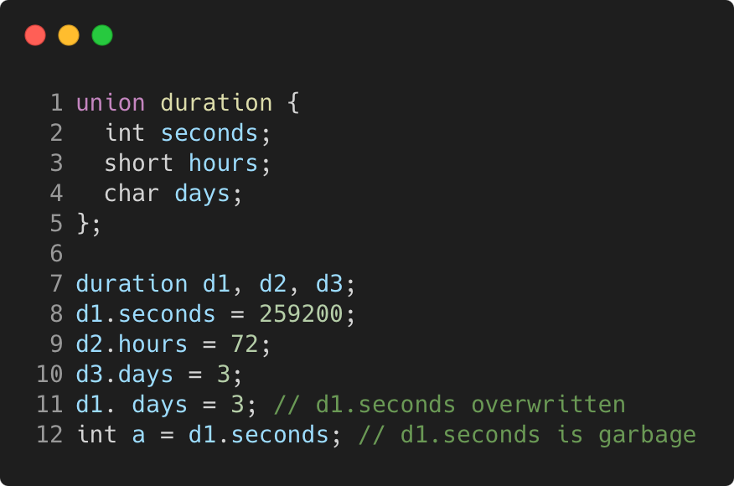
Union
C++98
Language Basics | Struct and enum types
“members” packed together at same memory location
Gammasoft
Modern C++ Course

Slide 77
Union
C++98
Language Basics | Struct and enum types
“members” packed together at same memory location
Memory layout
 |  |  |  | 0x300C
 |  |  |  | 0x3008
 |  |  |  | 0x3004
 |  |  |  | 0x3000
Gammasoft
Modern C++ Course

Slide 78
Union
C++98
Language Basics | Struct and enum types
“members” packed together at same memory location
Memory layout
 |  |  |  | 0x300C
? | ? | ? | ? | 0x3008
? | ? | ? | ? | 0x3004
? | ? | ? | ? | 0x3000
Gammasoft
Modern C++ Course

Slide 79
Union
C++98
Language Basics | Struct and enum types
“members” packed together at same memory location
Memory layout
 |  |  |  | 0x300C
? | ? | ? | ? | 0x3008
? | ? | ? | ? | 0x3004
 |  |  |  | 0x3000
259200
Gammasoft
Modern C++ Course

Slide 80
Union
C++98
Language Basics | Struct and enum types
“members” packed together at same memory location
Memory layout
 |  |  |  | 0x300C
? | ? | ? | ? | 0x3008
 |  | ? | ? | 0x3004
 |  |  |  | 0x3000
72
259200
Gammasoft
Modern C++ Course

Slide 81
Union
C++98
Language Basics | Struct and enum types
“members” packed together at same memory location
Memory layout
 |  |  |  | 0x300C
3 | ? | ? | ? | 0x3008
 |  | ? | ? | 0x3004
 |  |  |  | 0x3000
72
259200
Gammasoft
Modern C++ Course

Slide 82
Union
C++98
Language Basics | Struct and enum types
“members” packed together at same memory location
Memory layout
 |  |  |  | 0x300C
3 | ? | ? | ? | 0x3008
 |  | ? | ? | 0x3004
3 | ? | ? | ? | 0x3000
72
Gammasoft
Modern C++ Course

Slide 83
Union
C++98
Language Basics | Struct and enum types
“members” packed together at same memory location
Memory layout
? | ? | ? | ? | 0x300C
3 | ? | ? | ? | 0x3008
 |  | ? | ? | 0x3004
3 | ? | ? | ? | 0x3000
72
Gammasoft
Modern C++ Course

Slide 84
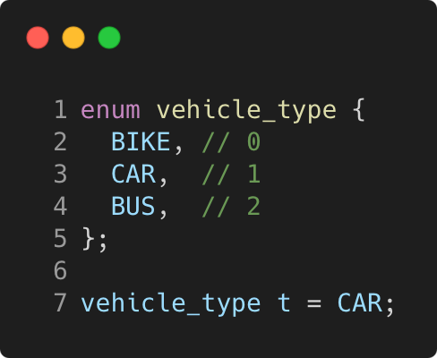
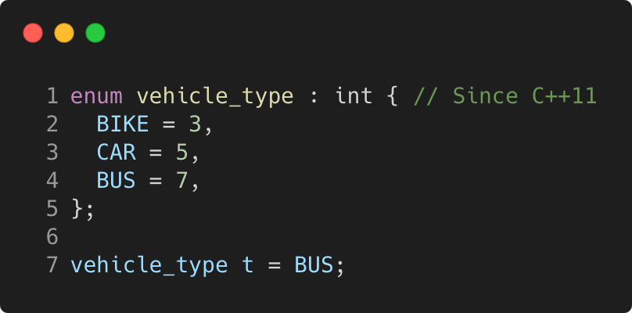
Enum
C++98
Language Basics | Struct and enum types
use to declare a list of related constants (enumerators)
has an underlying integral type
enumerator names leak into enclosing scope
Gammasoft
Modern C++ Course

Slide 85
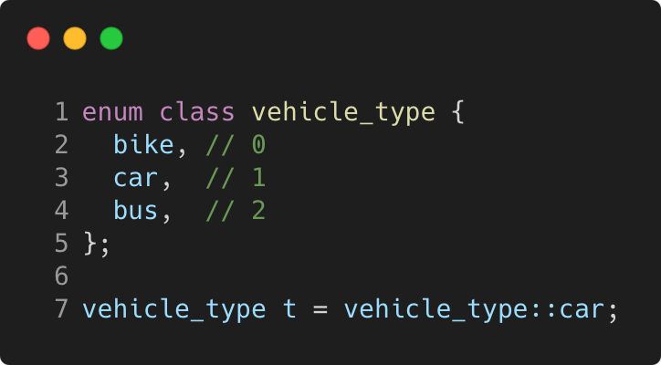
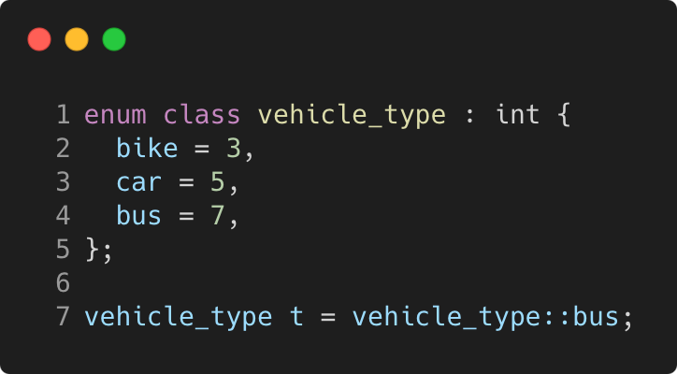
Enum class
C++11
Language Basics | Struct and enum types
scopes enumerator names, avoids name clashes
strong typing, no automatic conversion to int
Gammasoft
Modern C++ Course

Slide 86
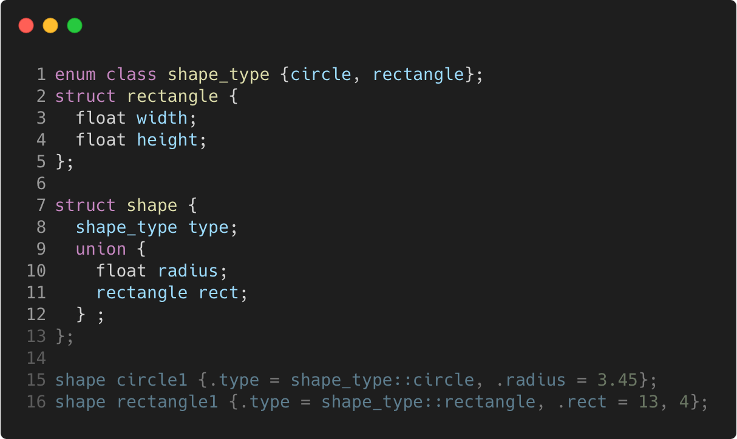
More concrete example
C++11
Language Basics | Struct and enum types
Gammasoft
Modern C++ Course

Slide 87
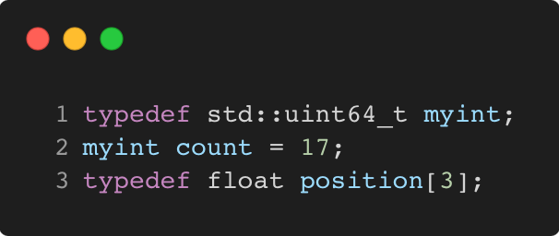
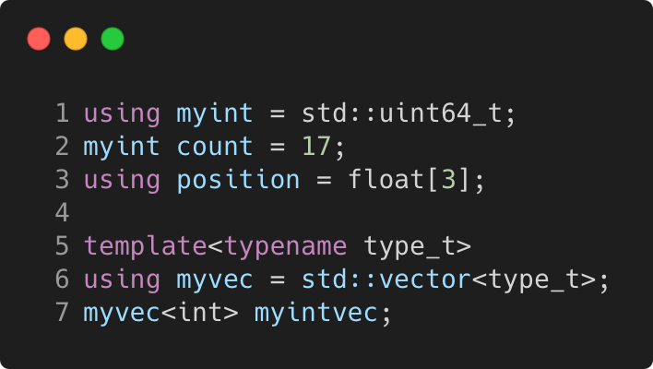
typedef and using
C++98 / C++11
Language Basics | Struct and enum types
C++98
C++11
Gammasoft
Modern C++ Course

Slide 88
Language Basics
Language Basics
Gammasoft
Modern C++ Course
Hello World
Core syntax and types
Arrays and Pointers
Scopes / namespaces
Struct and enum types
References
Functions
Operators
Control structures
Headers and interfaces
auto keyword
inline keyword
Assertions

Slide 89
Language Basics
Language Basics
Gammasoft
Modern C++ Course
Hello World
Core syntax and types
Arrays and Pointers
Scopes / namespaces
Struct and enum types
References
Functions
Operators
Control structures
Headers and interfaces
auto keyword
inline keyword
Assertions

Slide 90
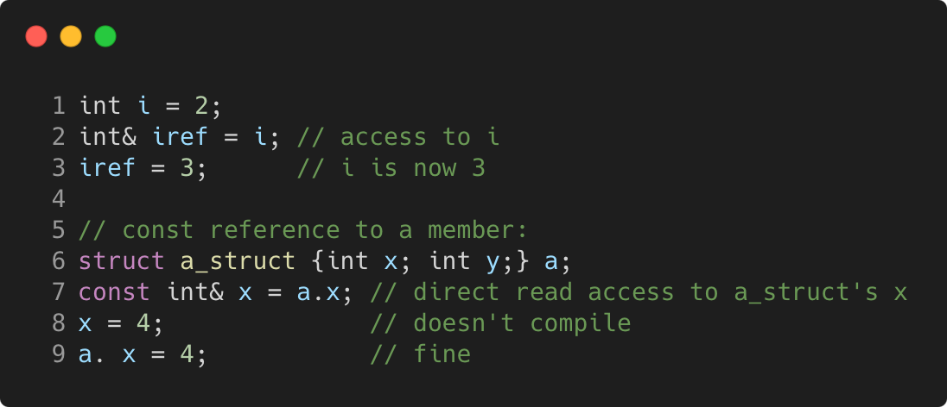
References
C++98
Language Basics | References
References allow for direct access to another object
They can be used as shortcuts / better readability
They can be declared const to allow only read access
Gammasoft
Modern C++ Course

Slide 91
References vs pointers
C++98
Language Basics | References
Natural syntax
Cannot be null
Must be assigned when defined, cannot be reassigned
Prefer using references instead of pointers
Mark references const to prevent modification
Gammasoft
Modern C++ Course

Slide 92
Language Basics
Language Basics
Gammasoft
Modern C++ Course
Hello World
Core syntax and types
Arrays and Pointers
Scopes / namespaces
Struct and enum types
References
Functions
Operators
Control structures
Headers and interfaces
auto keyword
inline keyword
Assertions

Slide 93
Language Basics
Language Basics
Gammasoft
Modern C++ Course
Hello World
Core syntax and types
Arrays and Pointers
Scopes / namespaces
Struct and enum types
References
Functions
Operators
Control structures
Headers and interfaces
auto keyword
inline keyword
Assertions

Slide 94
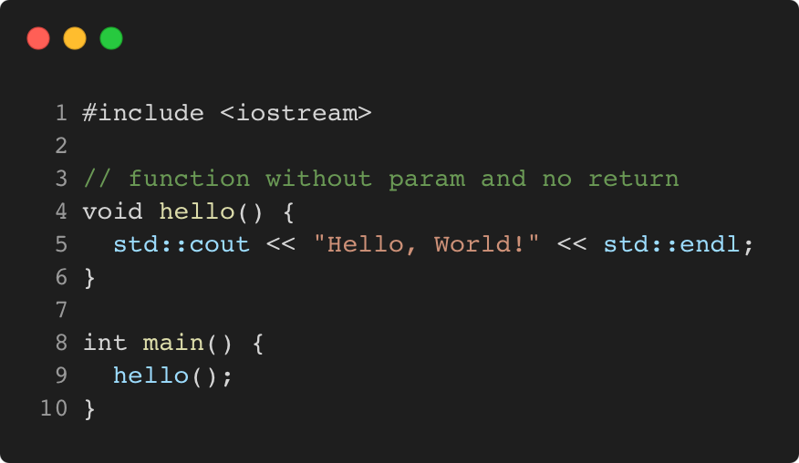
Function without param and no return
C++98
Language Basics | Functions
Gammasoft
Modern C++ Course

Slide 95
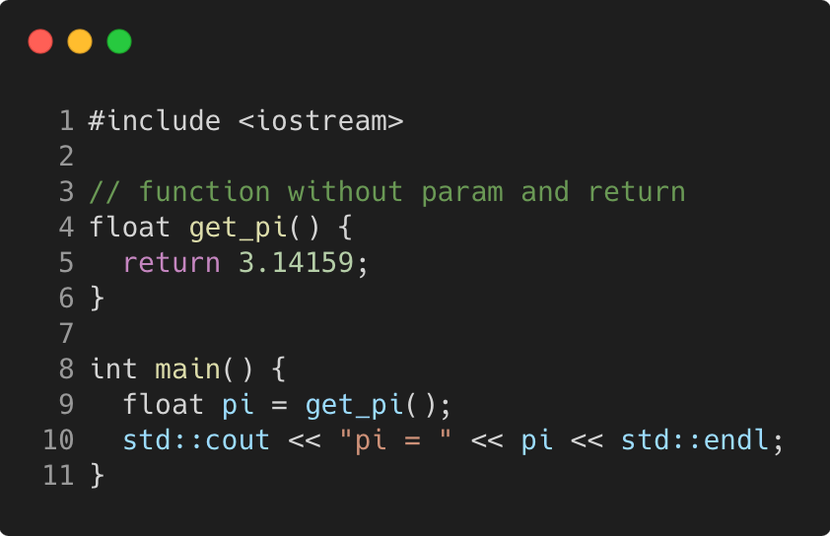
Function without param and return
C++98
Language Basics | Functions
Gammasoft
Modern C++ Course

Slide 96

Function with param and no return
C++98
Language Basics | Functions
Gammasoft
Modern C++ Course

Slide 97

Function with param and return
C++98
Language Basics | Functions
Gammasoft
Modern C++ Course

Slide 98

Function with params and return
C++98
Language Basics | Functions
Gammasoft
Modern C++ Course

Slide 99

Function with default argument
C++98
Language Basics | Functions
Gammasoft
Modern C++ Course

Slide 100

Function with default arguments
C++98
Language Basics | Functions
Gammasoft
Modern C++ Course

Slide 101

Functions and references to returned values
C++98
Language Basics | Functions
Gammasoft
Modern C++ Course

Slide 102

Parameters are passed by value
C++98
Language Basics | Functions
Gammasoft
Modern C++ Course

Slide 103

Parameters are passed by value
C++98
Language Basics | Functions
Memory layout
 | 0x31E0
 | 0x3190
 | 0x3140
 | 0x30F0
 | 0x30A0
 | 0x3050
 | 0x3000
Gammasoft
Modern C++ Course

Slide 104
Parameters are passed by value
C++98
Language Basics | Functions
Memory layout
 | 0x31E0
 | 0x3190
 | 0x3140
 | 0x30F0
sn | 0x30A0
... | 0x3050
s1 | 0x3000
{
s
Gammasoft
Modern C++ Course

Slide 105
Parameters are passed by value
C++98
Language Basics | Functions
Memory layout
{
 | 0x31E0
pn | 0x3190
... | 0x3140
p1 | 0x30F0
sn | 0x30A0
... | 0x3050
s1 | 0x3000
p
{
s
Gammasoft
Modern C++ Course

Slide 106
Parameters are passed by value
C++98
Language Basics | Functions
Memory layout
 | 0x31E0
 | 0x3190
 | 0x3140
q = 0x3000 | 0x30F0
sn | 0x30A0
... | 0x3050
s1 | 0x3000
{
s
Gammasoft
Modern C++ Course

Slide 107

Pass by value or reference ?
C++98
Language Basics | Functions
Gammasoft
Modern C++ Course

Slide 108
Pass by value or reference ?
C++98
Language Basics | Functions
Memory layout
 | 0x3008
 | 0x3004
 | 0x3000
Gammasoft
Modern C++ Course

Slide 109
Pass by value or reference ?
C++98
Language Basics | Functions
Memory layout
 | 0x3008
 | 0x3004
s.a = 1 | 0x3000
Gammasoft
Modern C++ Course

Slide 110
Pass by value or reference ?
C++98
Language Basics | Functions
Memory layout
 | 0x3008
p.a = 1 | 0x3004
s.a = 1 | 0x3000
Gammasoft
Modern C++ Course

Slide 111
Pass by value or reference ?
C++98
Language Basics | Functions
Memory layout
 | 0x3008
p.a = 2 | 0x3004
s.a = 1 | 0x3000
Gammasoft
Modern C++ Course

Slide 112
Pass by value or reference ?
C++98
Language Basics | Functions
Memory layout
 | 0x3008
 | 0x3004
s.a = 1 | 0x3000
Gammasoft
Modern C++ Course

Slide 113
Pass by value or reference ?
C++98
Language Basics | Functions
Memory layout
 | 0x3008
q = 0x3000 | 0x3004
s.a = 1 | 0x3000
Gammasoft
Modern C++ Course

Slide 114
Pass by value or reference ?
C++98
Language Basics | Functions
Memory layout
 | 0x3008
q = 0x3000 | 0x3004
s.a = 2 | 0x3000
Gammasoft
Modern C++ Course

Slide 115
Pass by value or reference ?
C++98
Language Basics | Functions
Memory layout
 | 0x3008
 | 0x3004
s.a = 2 | 0x3000
Gammasoft
Modern C++ Course

Slide 116

Different ways to pass arguments to a function
C++98
Language Basics | Functions
By default, arguments are passed by value (= copy) => good for small types, e.g. numbers
Use references for parameters to avoid copies => good for large types, e.g. objects
Use const for safety and readability whenever possible
Gammasoft
Modern C++ Course

Slide 117

Overloading
C++98
Language Basics | Functions
We can have multiple functions with the same name
Must have different parameter lists
A different return type alone is not allowed
Form a so-called “overload set”
Default arguments can cause ambiguities
Gammasoft
Modern C++ Course

Slide 118
Exercise : functions
Language Basics | Functions
Familiarise yourself with pass by value / pass by reference.
Go to exercises/functions
Look at functions.cpp
Compile it (make) and run the program (./functions)
Work on the tasks that you find in functions.cpp
Gammasoft
Modern C++ Course

Slide 119

Good practices
C++98
Language Basics | Functions
Write readable functions
Keep functions short
Do one logical thing (single-responsibility principle)
Use expressive names
Document non-trivial functions
Gammasoft
Modern C++ Course

Slide 120

Good practices
C++98
Language Basics | Functions
Don’t! Everything in one long function
Gammasoft
Modern C++ Course

Slide 121
Language Basics
Language Basics
Gammasoft
Modern C++ Course
Hello World
Core syntax and types
Arrays and Pointers
Scopes / namespaces
Struct and enum types
References
Functions
Operators
Control structures
Headers and interfaces
auto keyword
inline keyword
Assertions

Slide 122
Language Basics
Language Basics
Gammasoft
Modern C++ Course
Hello World
Core syntax and types
Arrays and Pointers
Scopes / namespaces
Struct and enum types
References
Functions
Operators
Control structures
Headers and interfaces
auto keyword
inline keyword
Assertions

Slide 123

Binary and Assignment Operators
C++98
Language Basics | Operators
Gammasoft
Modern C++ Course

Slide 124

Increment / Decrement Operators
C++98
Language Basics | Operators
Gammasoft
Modern C++ Course

Slide 125

Bitwise and Assignment Operators
C++98
Language Basics | Operators
Gammasoft
Modern C++ Course

Slide 126

Logical Operators
C++98
Language Basics | Operators
Gammasoft
Modern C++ Course

Slide 127

Comparison Operators
C++20
Language Basics | Operators
Gammasoft
Modern C++ Course

Slide 128

Operator Precedences
C++98
Language Basics | Operators
Avoid writing a line of operators as in the example on the right
It's better to decompose the expression
and to use parentheses
Details can be found on cppreference
Gammasoft
Modern C++ Course

Slide 129
Language Basics
Language Basics
Gammasoft
Modern C++ Course
Hello World
Core syntax and types
Arrays and Pointers
Scopes / namespaces
Struct and enum types
References
Functions
Operators
Control structures
Headers and interfaces
auto keyword
inline keyword
Assertions

Slide 130
Language Basics
Language Basics
Gammasoft
Modern C++ Course
Hello World
Core syntax and types
Arrays and Pointers
Scopes / namespaces
Struct and enum types
References
Functions
Operators
Control structures
Headers and interfaces
auto keyword
inline keyword
Assertions

Slide 131

if - syntax
C++98
Language Basics | Control structures
The else and else if clauses are optional
The else if clause can be repeated
Braces are optional if there is a single statement
Gammasoft
Modern C++ Course

Slide 132

if - example
C++98
Language Basics | Control structures
Gammasoft
Modern C++ Course

Slide 133

Conditional operator - syntax
C++98
Language Basics | Control structures
If test is true expression1 is returned
Else, expression2 is returned
Gammasoft
Modern C++ Course

Slide 134

Conditional operator - example
C++98
Language Basics | Control structures
Gammasoft
Modern C++ Course

Slide 135

Conditional operator - best practice
C++98
Language Basics | Control structures
Avoid writing a line of conditional operators as in the example on the right
Explicit ifs are generally easier to read
Use the ternary operator with short conditions and expressions
Avoid nesting
Gammasoft
Modern C++ Course

Slide 136

switch - syntax
C++98
Language Basics | Control structures
The break statement is not mandatory but...
Cases are entry points, not independent pieces
Execution “falls through” to the next case without a break!
The default case may be omitted
Avoid switch statements with fall-through cases
Gammasoft
Modern C++ Course

Slide 137

switch - example
C++11
Language Basics | Control structures
Gammasoft
Modern C++ Course

Slide 138

[[fallthrough]] attribute
C++17
Language Basics | Control structures
New compiler warning
Since C++ 17, compilers are encouraged to warn on fall-through
Gammasoft
Modern C++ Course

Slide 139

Init-statements for if and switch
C++17
Language Basics | Control structures
Purpose
Allows to limit variable scope in if and switch statements
Gammasoft
Modern C++ Course

Slide 140

Init-statements for if and switch
C++98
Language Basics | Control structures
Don’t confuse with a variable declaration as condition!
Gammasoft
Modern C++ Course

Slide 141

for loop - syntax
C++98
Language Basics | Control structures
Multiple initializations / increments are comma separated
Initializations can contain declarations
Braces are optional if loop body is a single statement
Gammasoft
Modern C++ Course

Slide 142

for loop - example
C++98
Language Basics | Control structures
Gammasoft
Modern C++ Course

Slide 143

Range-based loop - syntax
C++11
Language Basics | Control structures
Simplifies loops over “ranges” tremendously
Especially with std containers and ranges
Gammasoft
Modern C++ Course

Slide 144

Range-based loop - example
C++11
Language Basics | Control structures
Gammasoft
Modern C++ Course

Slide 145

Init-statements for range-based loop
C++20
Language Basics | Control structures
Purpose
Allows to limit variable scope in range-based loops
Gammasoft
Modern C++ Course

Slide 146

while loop - syntax
C++98
Language Basics | Control structures
Braces are optional if loop body is a single statement
Gammasoft
Modern C++ Course

Slide 147


while loop - example
C++98
Language Basics | Control structures
Gammasoft
Modern C++ Course

Slide 148
Jump statements
C++98
Language Basics | Control structures
Gammasoft
Modern C++ Course

Slide 149

Jump statements
C++98
Language Basics | Control structures
break Exits the loop and continues after it
Gammasoft
Modern C++ Course

Slide 150

Jump statements
C++98
Language Basics | Control structures
break Exits the loop and continues after it
continue Goes immediately to next loop iteration
Gammasoft
Modern C++ Course

Slide 151

Jump statements
C++98
Language Basics | Control structures
break Exits the loop and continues after it
continue Goes immediately to next loop iteration
return Exits the current function
Gammasoft
Modern C++ Course

Slide 152

Jump statements
C++98
Language Basics | Control structures
break Exits the loop and continues after it
continue Goes immediately to next loop iteration
return Exits the current function
Gammasoft
Modern C++ Course

Slide 153

Jump statements
C++98
Language Basics | Control structures
break Exits the loop and continues after it
continue Goes immediately to next loop iteration
return Exits the current function
goto Can jump anywhere inside a function, avoid!
Gammasoft
Modern C++ Course

Slide 154
Exercise : control
Language Basics | Control structures
Familiarise yourself with different kinds of control structures.
Re-implement them in different ways.
Go to exercises/control
Look at control.cpp
Compile it (make) and run the program (./control)
Work on the tasks that you find in README.md
Gammasoft
Modern C++ Course

Slide 155
Language Basics
Language Basics
Gammasoft
Modern C++ Course
Hello World
Core syntax and types
Arrays and Pointers
Scopes / namespaces
Struct and enum types
References
Functions
Operators
Control structures
Headers and interfaces
auto keyword
inline keyword
Assertions

Slide 156
Language Basics
Language Basics
Gammasoft
Modern C++ Course
Hello World
Core syntax and types
Arrays and Pointers
Scopes / namespaces
Struct and enum types
References
Functions
Operators
Control structures
Headers and interfaces
auto keyword
inline keyword
Assertions

Slide 157
Interface
C++98
Language Basics | Headers and interfaces
Set of declarations defining some functionality
Gammasoft
Modern C++ Course

Slide 158

Interface
C++98
Language Basics | Headers and interfaces
Set of declarations defining some functionality
Put in a so-called “header file”
hello.hpp
Gammasoft
Modern C++ Course

Slide 159

Interface
C++98
Language Basics | Headers and interfaces
hello.cpp
Set of declarations defining some functionality
Put in a so-called “header file”
The implementation can be found in the "source file"
Gammasoft
Modern C++ Course

Slide 160

Interface
C++98
Language Basics | Headers and interfaces
print_hello.cpp
main.cpp
print_hello.hpp
Gammasoft
Modern C++ Course

Slide 161
Preprocessor
C++98
Language Basics | Headers and interfaces
Gammasoft
Modern C++ Course

Slide 162

Preprocessor
C++98
Language Basics | Headers and interfaces
Constant macros
Gammasoft
Modern C++ Course

Slide 163

Preprocessor
C++98
Language Basics | Headers and interfaces
Constant macros
Function-style macros
Gammasoft
Modern C++ Course

Slide 164

Preprocessor
C++98
Language Basics | Headers and interfaces
Constant macros
Function-style macros
Checks
Gammasoft
Modern C++ Course

Slide 165
Preprocessor
C++98
Language Basics | Headers and interfaces
Constant macros
Function-style macros
Checks
Use preprocessor only in very restricted cases
Conditional inclusion of headers
Customization for specific compilers/platforms
Gammasoft
Modern C++ Course

Slide 166

Preprocessor
C++11
Language Basics | Headers and interfaces
Constant macros
Function-style macros
Checks
Use preprocessor only in very restricted cases
Conditional inclusion of headers
Customization for specific compilers/platforms
Gammasoft
Modern C++ Course

Slide 167

Preprocessor
C++98
Language Basics | Headers and interfaces
Constant macros
Function-style macros
Checks
Use preprocessor only in very restricted cases
Conditional inclusion of headers
Customization for specific compilers/platforms
Gammasoft
Modern C++ Course

Slide 168
Header include guards
C++98
Language Basics | Headers and interfaces
Problem: redefinition by accident
Headers may define new names (e.g. types)
Multiple (transitive) inclusions of a header would define those
names multiple times, which is a compile error
Gammasoft
Modern C++ Course

Slide 169

Header include guards
C++98
Language Basics | Headers and interfaces
Problem: redefinition by accident
Headers may define new names (e.g. types)
Multiple (transitive) inclusions of a header would define those
names multiple times, which is a compile error
Solution: guard the content of your headers!
Include guards
Gammasoft
Modern C++ Course

Slide 170

Header include guards
C++98
Language Basics | Headers and interfaces
Include guards
Problem: redefinition by accident
Headers may define new names (e.g. types)
Multiple (transitive) inclusions of a header would define those
names multiple times, which is a compile error
Solution: guard the content of your headers!
pragma once
Gammasoft
Modern C++ Course

Slide 171
Header / source separation
C++98
Language Basics | Headers and interfaces
Headers should contain declarations of functions / classes
Only create them if interface is used somewhere else
Might be included/compiled many times
Good to keep them short
Minimise #include statements
Put long code in implementation files. Exceptions:
Templates and constexpr functions
Short functions
Gammasoft
Modern C++ Course

Slide 172
Language Basics
Language Basics
Gammasoft
Modern C++ Course
Hello World
Core syntax and types
Arrays and Pointers
Scopes / namespaces
Struct and enum types
References
Functions
Operators
Control structures
Headers and interfaces
auto keyword
inline keyword
Assertions

Slide 173
Language Basics
Language Basics
Gammasoft
Modern C++ Course
Hello World
Core syntax and types
Arrays and Pointers
Scopes / namespaces
Struct and enum types
References
Functions
Operators
Control structures
Headers and interfaces
auto keyword
inline keyword
Assertions

Slide 174
Benefits
C++11
Language Basics | auto keyword
Robustness: If the expression's type is changed—including when a function return type is changed—it just works.
Performance: You're guaranteed that there's no conversion.
Usability: You don't have to worry about type name spelling difficulties and typos.
Efficiency: Your coding can be more efficient.
Gammasoft
Modern C++ Course

Slide 175

Benefits
C++11
Language Basics | auto keyword
Robustness: If the expression's type is changed—including when a function return type is changed—it just works.
Performance: You're guaranteed that there's no conversion.
Usability: You don't have to worry about type name spelling difficulties and typos.
Efficiency: Your coding can be more efficient.
Gammasoft
Modern C++ Course

Slide 176

Benefits
C++11
Language Basics | auto keyword
Robustness: If the expression's type is changed—including when a function return type is changed—it just works.
Performance: You're guaranteed that there's no conversion.
Usability: You don't have to worry about type name spelling difficulties and typos.
Efficiency: Your coding can be more efficient.
Gammasoft
Modern C++ Course

Slide 177

Declarations
C++11
Language Basics | auto keyword
Gammasoft
Modern C++ Course

Slide 178

for range loop
C++11
Language Basics | auto keyword
Gammasoft
Modern C++ Course

Slide 179

for range loop
C++17
Language Basics | auto keyword
Gammasoft
Modern C++ Course

Slide 180

Always initialized
C++11
Language Basics | auto keyword
Gammasoft
Modern C++ Course

Slide 181
Exercise : loops, references, auto
Language Basics | Control structures
Familiarise yourself with range-based for loops and references.
Go to exercises/loops_refs_auto
Look at loops_refs_auto.cpp
Compile it (make) and run the program (./loops_refs_auto)
Work on the tasks that you find in loops_refs_auto.cpp
Gammasoft
Modern C++ Course

Slide 182
Language Basics
Language Basics
Gammasoft
Modern C++ Course
Hello World
Core syntax and types
Arrays and Pointers
Scopes / namespaces
Struct and enum types
References
Functions
Operators
Control structures
Headers and interfaces
auto keyword
inline keyword
Assertions

Slide 183
Language Basics
Language Basics
Gammasoft
Modern C++ Course
Hello World
Core syntax and types
Arrays and Pointers
Scopes / namespaces
Struct and enum types
References
Functions
Operators
Control structures
Headers and interfaces
auto keyword
inline keyword
Assertions

Slide 184

Inline functions originally
C++11
Language Basics | inline keyword
Applies to a function to tell the compiler to inline it
That is, replace function calls by the function’s content (similar to how a macro works)
Only a hint, compiler can still choose to not inline
Avoids call overhead at the cost of increasing binary size
Gammasoft
Modern C++ Course

Slide 185

Major side effect
C++11
Language Basics | inline keyword
The linker reduces the duplicated functions into one
An inline function definition can thus live in header files
Gammasoft
Modern C++ Course

Slide 186
Inline functions nowadays
C++11
Language Basics | inline keyword
Compilers can judge far better when to inline or not
thus primary purpose is gone
Putting functions into headers became main purpose
Many types of functions are marked inline by default:
function templates
constexpr functions
class member functions
Gammasoft
Modern C++ Course

Slide 187

Inline variables
C++17
Language Basics | inline keyword
my_struct.hpp
Global or static member variable specified as inline
Same side effect, linker merges all occurrences into one
Allows to define global variables/constants in headers
Avoid global variables and global constants! static member are fine.
Gammasoft
Modern C++ Course

Slide 188


Inline variables
C++17
Language Basics | inline keyword
my_struct.hpp
program.cpp
Gammasoft
Modern C++ Course

Slide 189
Language Basics
Language Basics
Gammasoft
Modern C++ Course
Hello World
Core syntax and types
Arrays and Pointers
Scopes / namespaces
Struct and enum types
References
Functions
Operators
Control structures
Headers and interfaces
auto keyword
inline keyword
Assertions

Slide 190
Language Basics
Language Basics
Gammasoft
Modern C++ Course
Hello World
Core syntax and types
Arrays and Pointers
Scopes / namespaces
Struct and enum types
References
Functions
Operators
Control structures
Headers and interfaces
auto keyword
inline keyword
Assertions

Slide 191

Checking invariants in a program
C++98
Language Basics | Assertions
An invariant is a property that is guaranteed to be true during certain phases of a program, and the program might crash or yield wrong results if it is violated
“Here, ‘a’ should always be positive”
This can be checked using assert
The program will be aborted if the assertion fails
Gammasoft
Modern C++ Course

Slide 192

Good practice
C++98
Language Basics | Assertions
Assertions are mostly for developers and debugging
Use them to check important invariants of your program
Prefer handling user-facing errors with helpful error messages/exceptions
Assertions can impact the speed of a program
Assertions are disabled when the macro NDEBUG is defined
Decide if you want to disable them when you release code
Gammasoft
Modern C++ Course

Slide 193


Static assert
C++98
Language Basics | Assertions
Checking invariants at compile time
To check invariants at compile time, use static_assert
The assertion can be any constant expression (see later)
The message argument is optional in C++ 17 and later
Gammasoft
Modern C++ Course

Slide 194
Language Basics
Language Basics
Gammasoft
Modern C++ Course
Hello World
Core syntax and types
Arrays and Pointers
Scopes / namespaces
Struct and enum types
References
Functions
Operators
Control structures
Headers and interfaces
auto keyword
inline keyword
Assertions

Slide 195
Language Basics
Language Basics
Gammasoft
Modern C++ Course
Hello World
Core syntax and types
Arrays and Pointers
Scopes / namespaces
Struct and enum types
References
Functions
Operators
Control structures
Headers and interfaces
auto keyword
inline keyword
Assertions

Slide 196
Outline
Introduction
Language Basics
Object Oriented Programming (OOP)
Core Modern C++
Modern C++ Expert
Advanced Programming
Gammasoft
Modern C++ Course

Slide 197
End
Gammasoft
Modern C++ Course

